Slide 1
Implementation Strategies for Generative AI in 3D Model Reconstruction from 2D Medical Images
Presenter’s Name : N.MANIVASAGAN
Supervisor Name : Dr. W.JAISINGH
Department : School of Information Science
Date : 10-May-2025

Slide 2
Introduction
Medical imaging such as MRI, CT, and X-ray scans produce 2D images that plays vital role in
diagnosis and treatment planning.
Limitations/ Drawbacks of 2D Medical Images
Medical imaging procedures including MRI (Magnetic Resonance Imaging), CT (Computed Tomography
are having drawbacks such as radiation exposure, availability, and cost.
3D Medical image conversion advantages/Benefits
3D reconstruction from Medical images is an alternative way of achieving 3D models with significantly
low radiation exposure to the patient
Less cost
No need to be the patient available for everytime

Slide 3
Steps involving in 3D Reconstruction
Imaging Requirements of 3D Reconstruction
Acquisition of X-ray images 3D reconstruction from 2D X-ray images can be performed using single X-ray
images , two X-ray images or more X-ray images for several anatomical regions such as
femur, tibia, fibula, pelvis and spine.
Image Enhancement: X-ray images' are low in intensity, poor in contrast. The quality of the X-ray image can be improved by applying image enhancement to improve the assessment. Many approaches for improving the quality of X-ray images
have been proposed such as
Histogram Equalization(HE)
Adaptive Histogram Equalization (AHE)
wavelet transform coefficients (WT) also techniques used to suppress mixed noise both Gaussian and impulsive noise while keeping the image structures (edges)
Immobilisation during image acquisition: Immobilisation means fixing a body part to reduce or eliminate
the motion of a patient during the image acquisition process . During image acquisition, it is necessary to sustain the rigid relationship between the original anatomy and the acquisition device

Slide 4
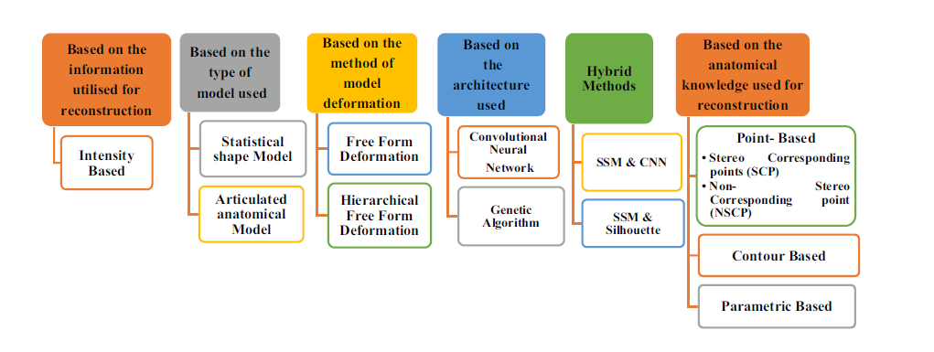
Categorization of 3D Reconstruction methods
1. Based on the Information Utilised for Reconstruction : example Intensity based
2. Based on the Type of Model Used -Statistical shape modelling: 3D Model built by statisticallyanalyzing a set of shapes is known as a SSM
3. Based on the Method of Model Deformation-Deformation techniques apply an adaptable deformation to a template model without taking into account any statistical data. A geometric approach called free-form deformation (FFD)
4. Based on the Architecture Used-Ex CNN and Genetic algorithm
5. Hybrid Methods
6. Based on the Anatomical Knowledge Used for Reconstruction

Slide 5
Literature Review
Reviewed around 70 articles and 30 journals
Recent advancements in deep learning, particularly GANs and VAEs, have revolutionized image synthesis and enhancement.
2. Studies have demonstrated the ability of these models to generate
high-quality images from low-resolution inputs,
enhance image clarity
synthesize new data for augmentation.
3. In the medical field, these techniques have been used for
image de noising,
super-resolution
segmentation.
However, their application in reconstructing accurate 3D models from 2D images is still emerging.

Slide 6
Literature Review: Summary of existing research
1.Diffusion Models
Gen-3Diffusion: This approach combines 2D foundation models with 3D generative models using diffusion-based techniques.
The synergy between 2D and 3D diffusion steps ensures 3D consistency and leverages strong prior information about 3D shapes
2. Depth Estimation and Point Cloud Generation:
Pre-trained Depth Estimation Models: Techniques like those demonstrated by the 3D-Reconstruction project use pre-trained models to predict depth maps from 2D images. These depth maps are then converted into 3D point clouds, which are refined and used to reconstruct 3D meshes
3. Neural Rendering:
Advanced Neural Networks: Neural rendering techniques utilize deep learning algorithms to transform 2D images into detailed and realistic 3D models. This involves depth estimation algorithms and neural networks to generate high-quality 3D representations

Slide 7
Key findings from previous studies
1. Improved Accuracy:
Generative AI models have promised superior performance in terms of accuracy and detail preservation in 3D reconstructions compared to traditional interpolation techniques.
2. Reduction in Data Requirements: By leveraging data augmentation and transfer learning, these models can achieve high-quality reconstructions even with a limited number of training samples.
3. Real-time Processing: Advances in model architectures and hardware acceleration have enabled real-time or near-real-time 3D reconstructions, which are essential for clinical applications.
4. Generalization Capabilities: Some studies have shown that generative AI models trained on specific datasets can generalize well to other datasets, although this is highly dependent on the diversity of the training data.

Slide 8
Identified Gaps in the Literature
Limited Clinical Validation: While many studies show promising results, there is a lack of extensive clinical validation to confirm the efficacy and safety of these generative models in real-world medical settings.
Data Diversity: Most models are trained on specific datasets, which may not represent the diversity of anatomical variations across different populations, leading to potential biases.
Interpretability and Transparency: Generative AI models, especially GANs, are often seen as "black boxes," making it challenging to interpret the rationale behind certain reconstructions. This can be a barrier to clinical adoption where transparency is crucial.
Integration with Clinical Workflows: There is a need for research on integrating these models into existing clinical workflows, ensuring they complement rather than disrupt standard practices.
Regulatory and Ethical Considerations: The deployment of AI-driven medical technologies raises questions about data privacy, consent, and the ethical implications of automated decision-making in healthcare.

Slide 9
Objectives of the Research
Primary Objectives
1. Develop and Validate Generative AI Models:
To design and validate generative AI models, such as GANs and VAEs, that can accurately reconstruct 3D anatomical structures from 2D medical images.
To evaluate the performance of these models in various medical imaging modalities (e.g., MRI, CT, X-ray)
2.Assess Clinical Applicability and Integration:
To assess the clinical applicability of the generative AI models in various medical fields, including radiology, orthopedics, and cardiology.
To develop strategies for integrating these models into existing clinical workflows, ensuring they enhance clinical decision-making processes without causing disruptions.

Slide 10
Objectives of the Research
Secondary Objectives
1. Enhance Model Interpretability and Transparency:
To investigate methods for improving the interpretability of generative AI models, making it easier for clinicians to understand and trust the generated 3D reconstructions.
To develop tools or frameworks that provide insights into the decision-making process of these AI models.
2.Ensure Data Diversity and Minimize Bias:
To curate and use diverse datasets for training and validating the models, ensuring the generalizability of the AI systems across different patient demographics and anatomical variations.
To analyze and mitigate potential biases in the AI models
3. Ethical Considerations:
To explore the ethical considerations for deploying generative AI technologies in healthcare,

Slide 11
Methodology
Data Analysis Techniques
1.Model Evaluation Metrics:
Quantitative Metrics: Accuracy, Dice coefficient, Intersection over Union (IoU), Mean Squared Error (MSE), and Peak Signal-to-Noise Ratio (PSNR) will be used to quantitatively assess the reconstruction quality.
Qualitative Analysis: Visual inspection and expert review will be conducted to assess the anatomical plausibility and clinical utility of the reconstructed 3D models.
2.Comparative Analysis:
Performance comparisons between different generative AI models (e.g., GANs, VAEs, NeRF) and traditional methods will be conducted to identify strengths and weaknesses.
3.Statistical Analysis:
Statistical tests will be applied to determine the significance of differences in performance metrics across different models and datasets.

Slide 12
Achievements:
1. Completed the Coursework of all 4 papers suggested in the First DC meeting
2.Seminar/Conference :
Attended “Next Generation Digital Security in Defence with QUANTUM ARTIFICIAL INTELLIGENCE and DECENTRALIZED BLOCKCHAIN SOLUTIONS” on 23rd Jan and 24th Jan 2025 conducted by Presidency University
S.No | Course Code | Subject Name | Status | Credits | Grade
1 | RES802 | Research Methodology and Publication Ethics for Computer Science and Engineering | Completed | 4 | B+
2 | CSE898 | Machine Learning Algorithms | Completed | 3 | A
3 | CSC868 | Deep Learning | Completed | 3 | A
4 | CSE5020 | Medical Image Processing | Completed | 3 | A

Slide 13
Tools and Instruments
Software and Libraries:
Deep Learning Frameworks:
PyTorch and TensorFlow will be used for implementing and training generative AI models.
Image Processing Tools: Tools like SimpleITK, OpenCV, and ITK-SNAP for image preprocessing, segmentation, and visualization.
Data Management:
Databases such as SQL or NoSQL systems for managing large datasets, along with tools like Apache Spark for big data processing.
Computational Resources:
High-Performance Computing (HPC) Clusters: For training large models on high-resolution datasets.
GPUs: Utilized for accelerating deep learning model training and inference.
Clinical Validation Tools: Instruments for expert assessment of 3D models, possibly including 3D printing for physical model validation.
Data Anonymization Software: Tools to ensure patient data privacy and compliance with data protection regulations.
Documentation and Reporting Tools: Systems to maintain detailed records of experiments, model parameters, and results for transparency and reproducibility.
ff

Slide 14
Thank You

